Slide 1
System Design Technique Guide
VS SW Process Unit
LG Electronics Inc.

Slide 2
Document Info
Document Information
Issuing authority | VS SW Process Unit
Status of document | In Progress / Approved / Released
Revision History
Version | Date | Comment | Author | Approver
1.0 | 2012.07.30 | Initial Release | EPG | VC Dev. Engineering FD
1.1 | 2018.02.12 | Modification of review of system architecture alternatives | VS SW Process Unit | VS SW Process Unit leader
1.2 | 2019.02.12 | Update due to annual organization restructuring (VC --> VS) | VS SW Process Unit | VS SW Process Unit leader
1.3 | 2019.6.10 | Delete document security level footer (LGE Confidential) | VS SW Process Unit | VS SW Process Unit leader

Slide 3
Contents
System Design Overview
System Architectural Drivers
System Context
System architecture design
System Dynamic Design
HIS
Review System Architecture Alternatives
System Architecture Specification

Slide 4
1. System Design Overview
System design aims to identify system architectural drivers that are the target of system design and define a system architecture that can satisfy them.
System design is carried out according to the following approach.
Architectural Drivers Definition
It defines the main functions that are the target of the system architecture, the main quality attribute requirements, and the main constraints.
System Context Definition
Define system boundaries, identify external entities that communicate with the system, and define external interfaces with them..
system static design
Identifies the system elements (HW, SW, ME) that can fulfill the system functional requirements.
Defines interfaces for input/output between system elements. (including HSI)
System Dynamic Design
Design the main operation of the system based on the system element.
5) Review system architecture alternatives
Through function division and integration, and quality attribute assignment, various system configuration plans are derived.
The optimal system architecture is selected by reviewing the derived system configuration methods..
6) System architecture specification
Based on the defined content and the selected system architecture, a system architecture design document (SysAD) is prepared.

Slide 5
2. System Architectural Drivers
Defining System Architectural Drivers
System Architectural Drivers set goals for system design. Identify the key functions the system will perform, key quality attribute requirements, and key design constraints. The identified system Architectural Drivers should be satisfied through system design and verified through system design alternatives review.
System Architectural Drivers It consists of the following items.
Main system function: Identifies the main system function through a table or use case.
Main quality attribute requirements: The main quality attribute requirements that the system must satisfy, such as functionality, reliability, performance, maintainability, usability, and durability.
Main Design Constraints: Describe business or technical constraints.
System Architectural Drivers include, but are not limited to, the above.

Slide 6
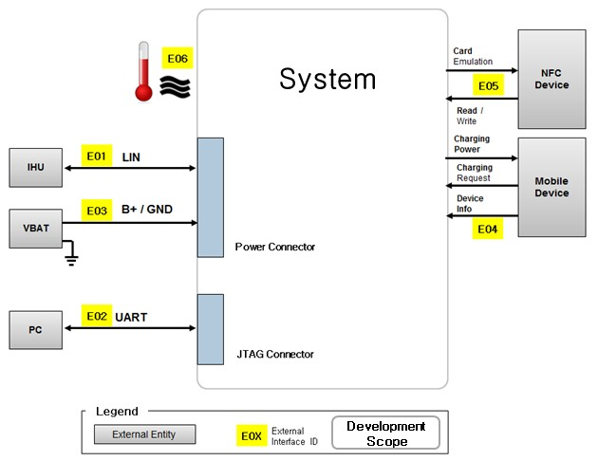
3. System Context
System Context Definition
The system context identifies the external entities and interfaces with which the system communicates. Through this, the system operating environment is identified and the system boundary and development scope are clarified.
The system context diagram consists of the following items.
System boundary: It is expressed as a black box, and the interior is not generally expressed.
External Entity: An external entity that communicates with the system (user, external system, other device)
External Interface: Defines the interface between the system and external entities.
System Context Notation and Examples

Slide 7
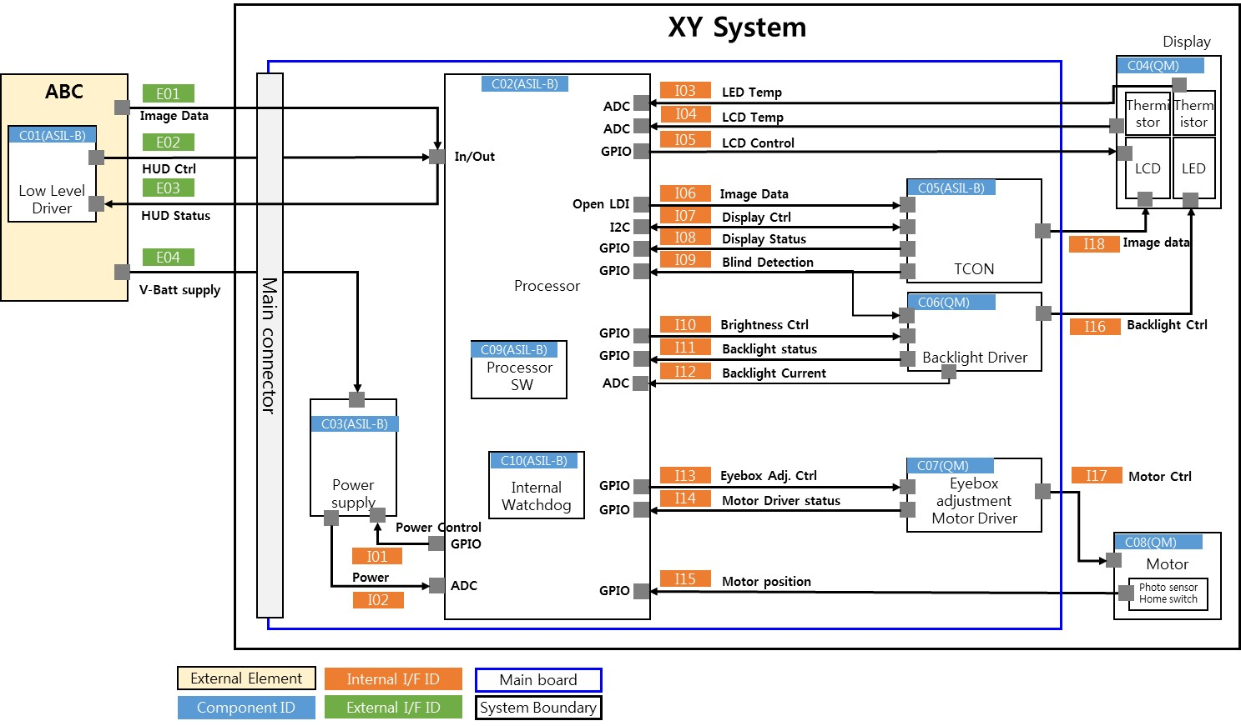
4. System Architecture Design
system architecture design
Create a system architecture based on the previously defined system architectural driver.
The system architecture consists of the following items.
System structure . System Architecture: Defining the static and dynamic architecture of the overall system.
. System Elements: Description of main functions and internal configuration of each system element.
. System Interfaces: Description of the type and range of input/output values for each system interface
- Other Requirements: Define requirements for mass production or later operational phases
System Architecture (static) notation and examples
[notation summary]
[System architecture example]
Block | System Element A physical element that composes a system. A system element may be seen in its turn as a system (i.e. sub-system) and be engineered in a system block at lower level. A system element can be hardware, software, data, procedure, facility, person, or any combination.
Flow | Interface A physical interface is a input-output flow that binds physically two system elements. Equivalent terms may be Link, or Comment

Slide 8
4. System Architecture Design – Identification of system elements
[[Identification of system elements]
The main components (system elements) that implement system functions are identified based on the following criteria.
The following approaches can be applied for system element identification.
-Components for processing core functions (CPU, Image processor, MPU, SW, instruments, optics, etc.)
-Components that provide inputs necessary for processing core functions (sensors, cameras, CAN signal processing, etc.)
-Components that output results (Display, LED, etc.)
-Components that support core function processing (Memory, Controller, etc.)
- Modules sourced in the form of semi-finished products (Display, Camera, etc.)
-System Element granularity: It has a unique function/purpose, and it should be at a level where requirements and responsibilities can be assigned.
- Among System Elements, SW Elements are identified in units of processors. (For example, if there are two processors, two SW elements are identified)
It aims at identification of system elements with autonomous characteristics for a modular architecture. To this end, functional requirements can be classified as follows and assigned to system elements.
Specific vs. Generic (separation of functions that can be generalized)
Optional vs. Essential (separation of functions that are expected to change)
Independence vs. Dependence (separation of functions that need to be independent/independent. eg safety mechanisms are segregated)
System elements for implementing system requirements can be used by using existing ones or by defining new elements.
Existing system elements that meet the functional requirements exist
Existing system elements that perform similar functional requirements exist, but the system elements need to be modified.
In addition, if there is a constraint that must use the existing system element, it is necessary to check whether the requirements to be performed through this system element need to be adjusted.
The existing system element does not exist, so the definition of a new system element is required.
A unique ID is assigned to the identified system element, and the necessary spec. is arranged in a table so that it is reflected in HW design and part selection.

Slide 9
4. System Architecture Design - System Interface Definition(1/2)
[system interface definition]
Defines interfaces for input/output exchange between functional requirements assigned to different system elements. For system elements including double SW, HW-SW interface is defined separately.
When defining an interface, it is defined according to the following criteria.
Use of standardized interfaces: Use of standardized or published interfaces
Minimize interface complexity: keep interactions between elements to a minimum
Tiered Architecture Orientation: Tiered Architecture Type Structure Orientation
Use of standardized interfaces
As for the interface, it is desirable to use an interface that is standardized and used in the industry or an interface whose specifications are open. The following is an example of a standardized interface.
Serial Communication Interfaces (SCI): RS-232, RS-422, RS-485 etc.
Synchronous Serial Communication Interface: I2C, SPI, SSC and ESSI (Enhanced Synchronous Serial Interface)
Universal Serial Bus (USB)
Multi Media Cards (SD Cards, Compact Flash etc.)
Networks: Ethernet, LonWorks, etc.
Fieldbuses: CAN-Bus, LIN-Bus, PROFIBUS, etc.
Timers: PLL(s), Capture/Compare and Time Processing Units
Discrete IO: aka General Purpose Input/Output (GPIO)
Analog to Digital/Digital to Analog (ADC/DAC)
Debugging: JTAG, ISP, ICSP, BDM Port, BITP, and DB9 ports
Minimize interface complexity
Interface complexity is expressed in how many interactions between system elements or the number of different interfaces, and aims to minimize this. Interface complexity can be determined using metrics such as coupling rate.

Slide 10
4. System Architecture Design - System Interface Definition(2/2)
Example of Rate Measurement Method Using Coupling Matrix
[Coupling Rate Calculation Method]
Coupling Rate = # of interface / # of possible interface
System coupling rate = internal cohesion rate – external coupling rate
S1 coupling rate = 3/6 – (4/18 + 6/18) = -1/18
S2 coupling rate = 3/6 – (6/18 + 7/18) = -4/18
S3 coupling rate = 2/6 – (4/18 + 5/18) = -3/18
Average(S1, S2, S3) = -0.148
+1: low coupling, -1: high coupling
[Coupling Matrix]
E1 |  | X |  |  | X
 | E2 | X | X |  |  |  | X
X |  | E3 |  |  | X
 | X |  | E4 | X |  |  | X
 | X |  |  | E5 |  | X |  | X
X |  | X | X | X | E6
 |  |  |  | X |  | E7 |  | X
 | X |  | X |  |  |  | E8
X |  |  |  | X |  | X |  | E9
. E1 to E9: system element. X: between system elements with an interface
show the case.
To right: left -> right relationship.
Left Down: Right -> Left Relationship
S1
S2
S3
Tiered Architecture Orientation
Tiered Architecture refers to a structure in which system elements are arranged in vertical tiers, horizontal interfaces between elements on the same tier are prohibited, and only a downward interface is allowed between elements on different tiers. It is an architectural structure that is widely used for system modularization. When defining interfaces, Tiered Architecture should be oriented.
Architecture structure example
Incorporated Architecture
Modular Architecture
Modular Architecture

Slide 11
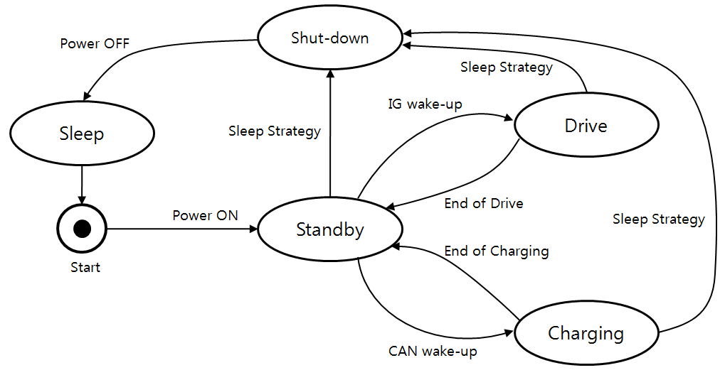
5. System Dynamic Design (1/4)
System Dynamic Design
Create a system-level dynamic design based on the previously defined system architecture. Dynamic design includes:
[Define Operation Modes] Define the operating mode and transition conditions of the system/software
[Define Scenarios of Functions] Define major operating scenarios by operating mode
[Define Operation Modes]
It defines the operating modes that the system/software can have, and defines the transition conditions for the operating mode, and the functions performed in each operating mode. This can be expressed through a state machine.
Operation mode (or state): Defines operation modes such as On/Off, Standby, Run, Sleep, and Maintenance.
Functions performed in the operating mode (or state): Describes the functions performed in the operating mode.
Transition between operating modes: Defines an event that causes transition between operating modes.
An operation mode may have one or more Operation Scenarios.
State Machine Example
Operation Mode Example
System X includes eight operational modes; transitions between modes are specified in diagram D
System X transits from “Off-mode” to “Standby-mode” by the switch-on event
Every operational mode can be interrupted by the switch-off command; then system X transits to the “Off-mode”
In “M-mode” system X satisfies functional requirements of section S of document D

Slide 12
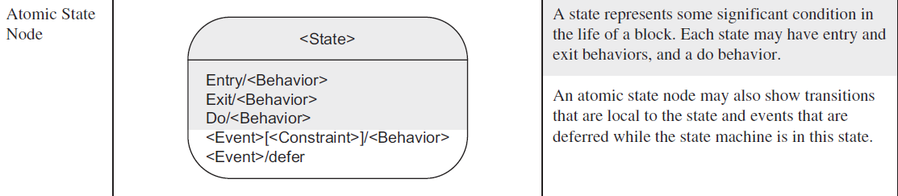
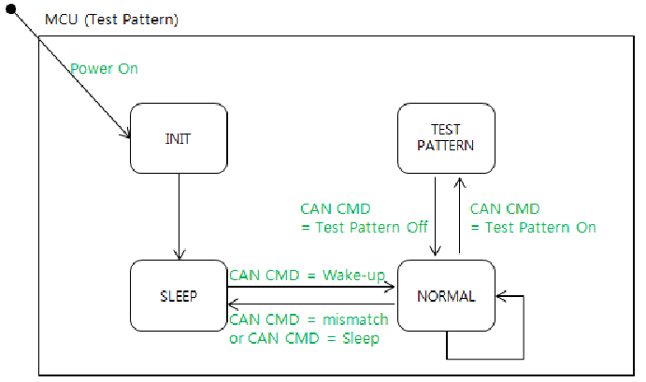
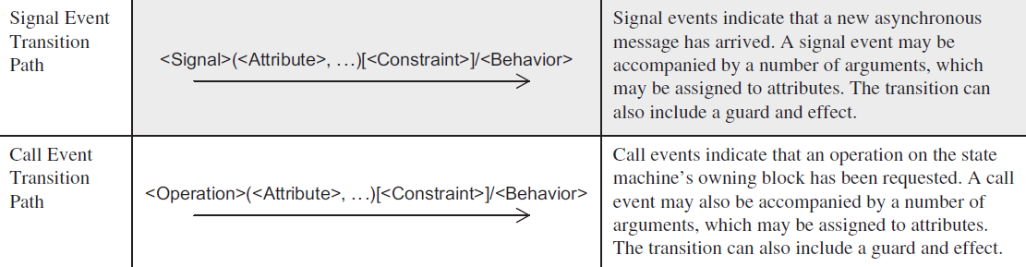
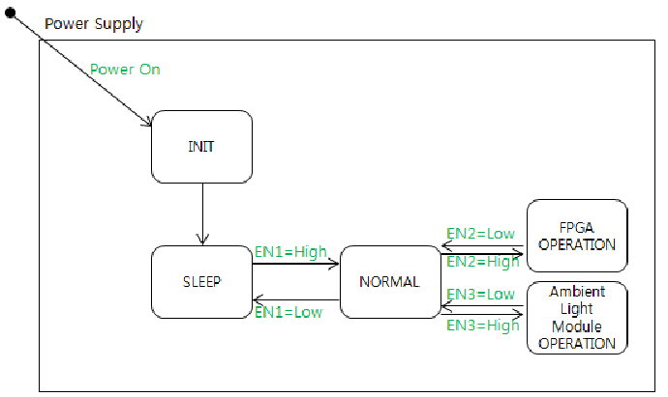
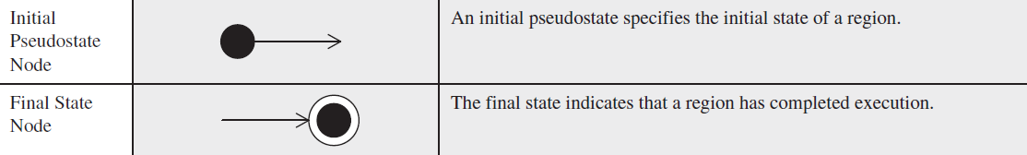
5. System Dynamic Design (2/4)
State Machine (SysML) Notation and Examples
[notation summary]
[Example]

Slide 13
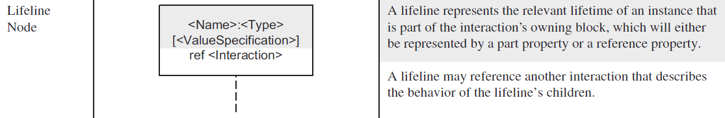
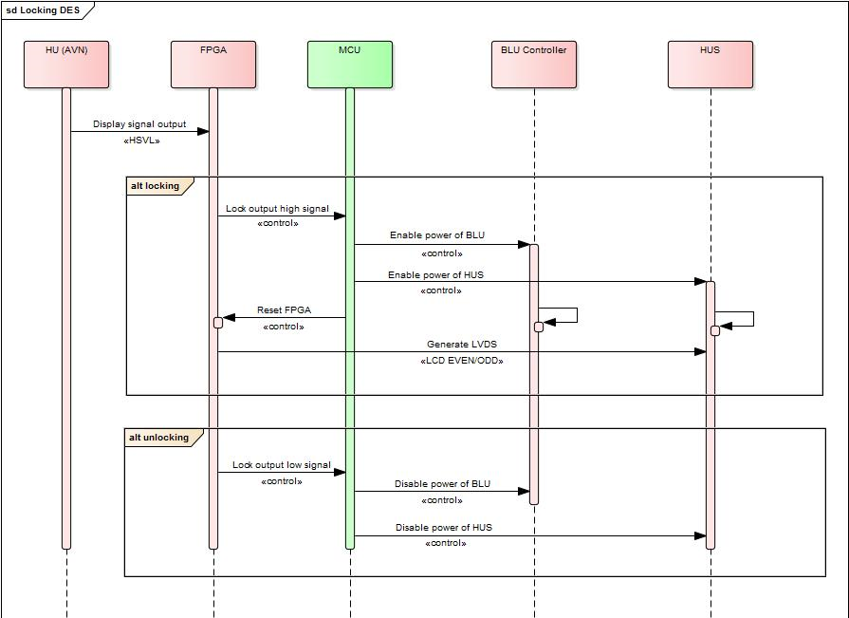
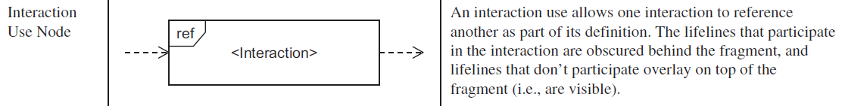
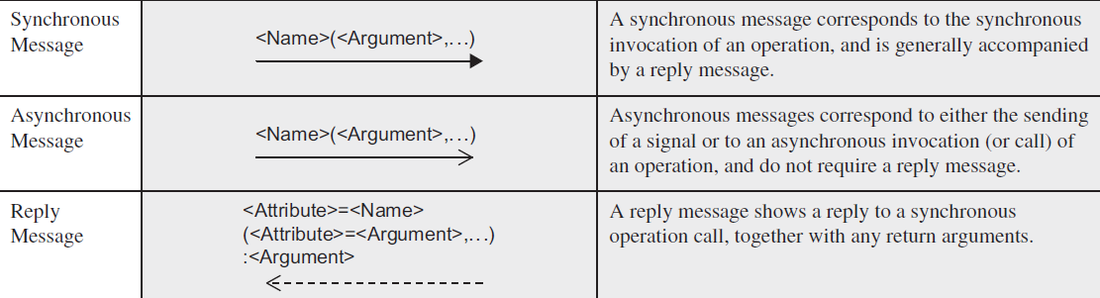
5. System Dynamic Design (3/4)
[Define Scenarios of Functions]
Design dynamic mechanisms for major operating scenarios (by operating mode). Dynamic design is expressed as a relationship between external entities and system elements identified in the system architecture. It mainly covers the following topics, but is not limited thereto.
Mechanisms for Main functions (eg Display, Object Detection)
Power On/Off or power sequence mechanism
Watchdog mechanism
Diagnosis Mechanism
Safety mechanism
Dynamic design can be expressed as the following sequence diagram or activity diagram, but is not limited thereto.
Sequence Diagram (SysML) Notation and Examples
[notation summary]
[Example]

Slide 14
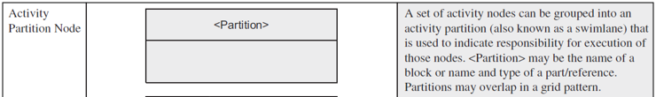
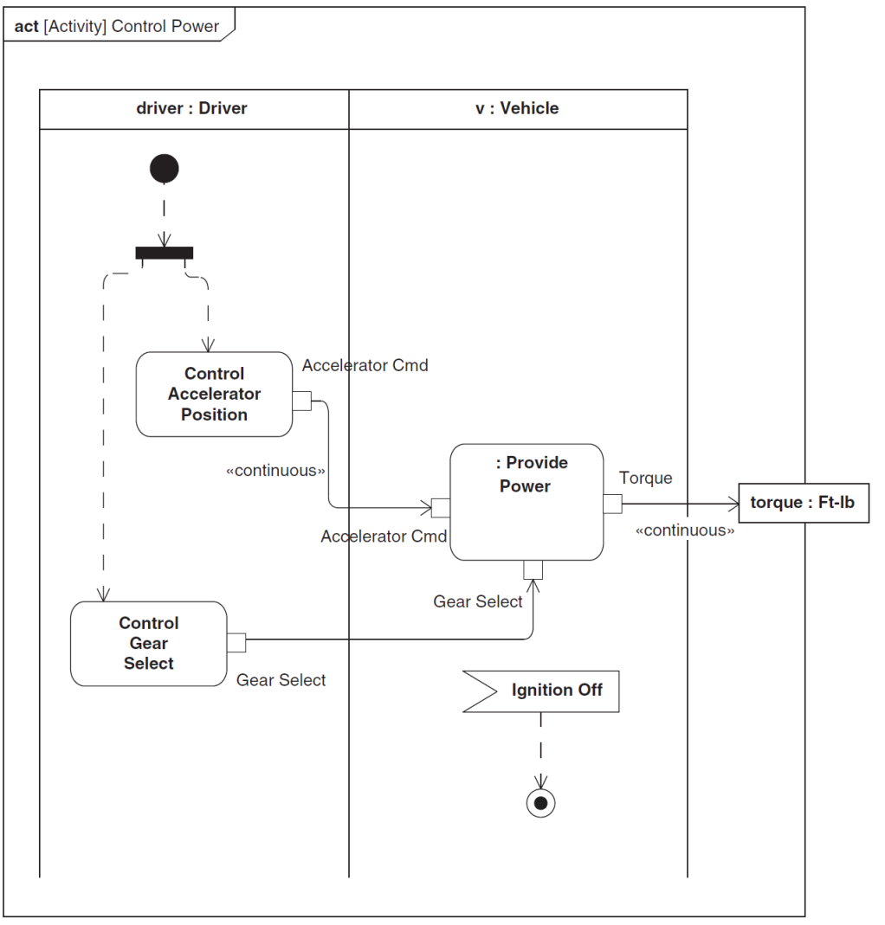
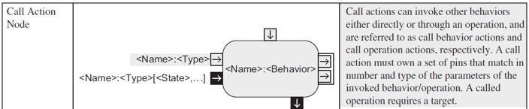
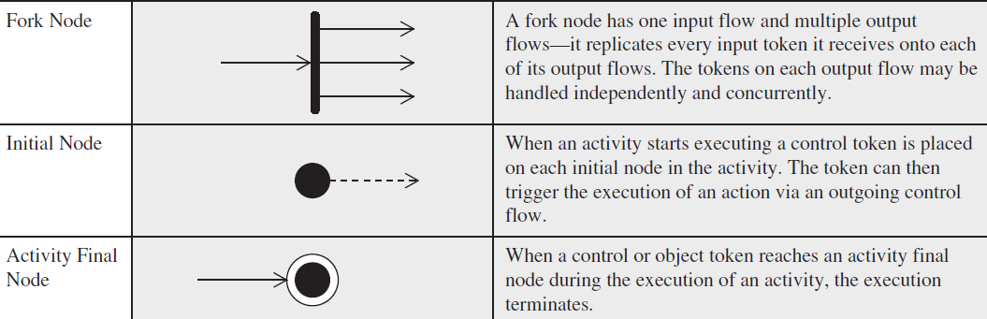
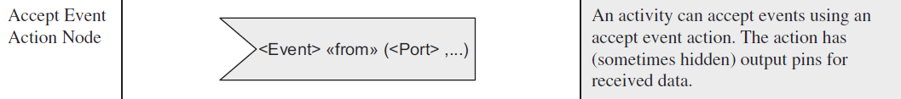
5. System Dynamic Design (4/4)
Activity Diagram (SysML) Notation and Examples
[notation summary]
[Example]

Slide 15
6. HSI
HW – SW Interfaces
It is designed for the interface with ECU (MCU) HW where SW operates.
These include ADC, GPIO, SPI, and I2C, which require direct access to electrical input/output signals coming through ECU registers.
HSI is identified in the system design stage and detailed in the HW and SW development stage.
If a separate HSI specification is prepared during system design, this document can be referred to in the system architecture design document.
Use the form below, but add pictures if necessary.
[HSI list form]
Hardware |  |  |  |  |  | Software
IF_ID | Sys Element | PIN_ID | Signal Name | Signal type | Signal Value/ Range | Register name | Variable Name | Initial Value | Description
I01 SPI | CPU | PE[4] | SPI0_SCK | OUT | LVTTL | NA | NA | NA | SPI clock
 |  | PE[5] | SPI0_SSO | OUT | LVTTL | NA | NA | NA | SPI chip select
 |  | PC[5] | SPI0_MOSI | OUT | LVTTL | DSPI1_PUSHR | MPSoC_SPITxbuf | 0 | SPI master output
 |  | PC[4] | SPI0_MISO | IN | LVTTL | DSPI1_POPR | MPSoC_SPIRxbuf | 0 | SPI master input
…

Slide 16
7. Review System Architecture Alternatives
Review System Architecture Alternatives
The system architecture must satisfy the system architectural driver. To this end, various alternative solutions are identified/evaluated/selected at the architectural level. This can be a partial solution or a whole structure.
[Deduction of system configuration plan] Deriving various system configuration plans through function division and integration, and quality attribute assignment
[Define the criteria for reviewing system architecture alternatives] Define the evaluation criteria for alternatives.
[Review of system architecture alternatives] Select the optimal system architecture by reviewing the derived system configuration plans
[1. Derivation of system configuration plan]
Divide and integrate functions assigned to system elements, and derive various system configuration plans while assigning quality attributes..
When dividing/integrating functions for system elements, refer to the following criteri.
Interface Criteria: Functions with the same input/output flow can be grouped and assigned to the same system element.
Effectiveness Criteria: Integrated consideration of functions that share the same resources, such as memory, power (voltage level), timer (clock), and communication bus.
Temporal Criteria: Functions with similar execution cycles can be grouped and assigned to the same system element.
Technology Criteria: Functions performed by similar technologies can be grouped and assigned to the same system element.
Control Strategy: Consider dividing/integrating related functions according to whether to concentrate/distribute the functions that control the order of functions and the timing of execution in one place.
Dependability Criteria: Functions related to quality attributes such as availability, reliability, maintainability, and safety consider overlapping/independent functions as necessary.
Environment Criteria: Functions operating under similar environmental conditions (electromagnetic waves, heat, temperature, humidity, etc.) can be collectively allocated for protection device application or divided and allocated for reliability.
Organizational Criteria: Consideration of constraints on the selection of system elements based on organizational criteria such as availability of elements, cost, schedule, and facility availability..
The allocation of quality attributes is divided into the case where it is assigned to individual system elements and the case where it is related to multiple or all elements.
When assigned to individual system elements
Standard compliance (e.g., connector ), Performance requirements (e.g., image resolution, accuracy,)
When involving multiple or all elements
Physical constraints (e.g., size, volume, weight), Power distribution requirements, Reliability requirements (e.g., random hardware fault rate)
Performance requirements (e.g., response time, fault tolerance time interval), Maintainability requirements (e.g., modular design)
Environment resistance requirements (e.g., EMC/EMI, moisture, temperature)

Slide 17
7. Review System Architecture Alternatives
[2. Definition of System Architecture Alternative Review Criteria]
The evaluation criteria for reviewing the derived system configuration methods are established.
- Evaluation criteria should include quality attributes (예, modularity, maintainability, expandability, scalability, reliability, security, usability) If it is difficult to satisfy all quality attributes, trade-off analysis is required in consideration of priorities
Evaluation criteria may include make-buy-reuse analysis. The following factors can be factors that determine make, buy, and reuse.
Are the criteria within the organization that influence system architecture considered? (e.g. availability of system elements, cost, schedule, facility availability, etc.)
Available resources, skills and costs
Critical delivery and consolidation schedules
Market research for available products, including COTS products
Potential suppliers' skills and capabilities
Core competencies
Licenses, warranties, responsibilities, and limitations related to the product to be purchased
[3. System architecture alternative review]
The derived system configuration methods are evaluated (reviewed) according to the evaluation criteria and a solution for the optimal system architecture is selected. The rationale for system architecture selection should be recorded in the system architecture design document or prepared as a separate analysis document.

Slide 18
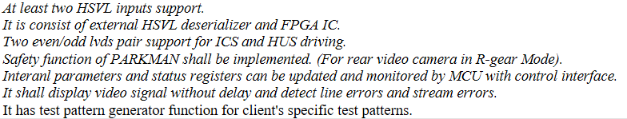
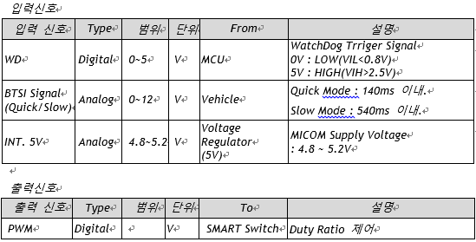
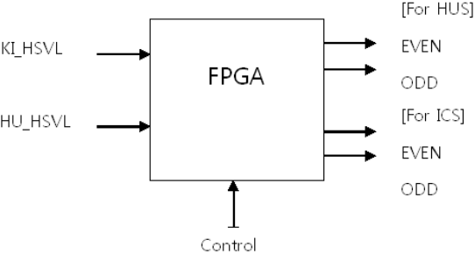
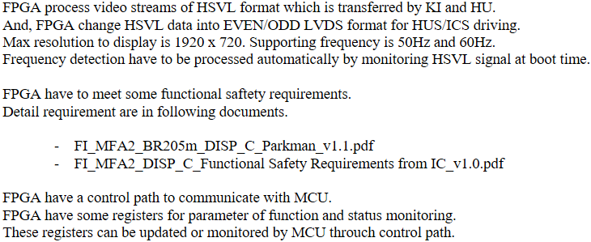
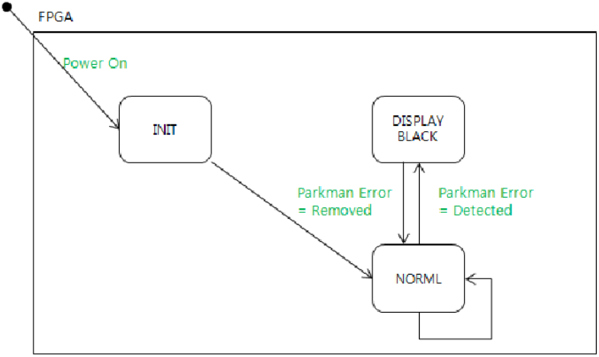
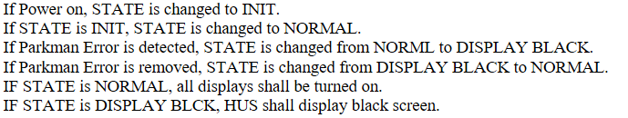
8. System Architecture Specification
Based on the drawing-oriented information created so far, it defines the details necessary for creating the SysAD document.
Example of System Architecture Specification : System Element, System Interface
[Example of System Element Specification]
[Example of System Interface Specification]
FPGA
Watchdog Interface

Slide 19
8. System Architecture Specification
All system elements and interfaces are given a consistent identifier.
e.g., system elements: C01, C02, …
External interface: E01, E02, …
Internal interface: I01, I02, …
Keep the serial number of the identifier as short as possible. In the case of 99 or less, it is expressed with two digits (XY).
Defines the necessary properties for the contents described in the system architecture design. System architecture properties can be determined and used according to the project.
Example system architecture properties
Parent Traceability: Traceability information with system requirements
Sub-Traceability: Traceability information with sub-requirements (HW, SW)Verification target: Whether it is a verification target through system integration test activities
Verification method (VM): SyIT, Review, Analysis, etc.
Verification Criteria (VC): Criterion (VC) for judging whether the verification by the verification method (VM) has passed
Applied variants (Variants): If the system has a variant model, the applicable variant model is specified.
Reference information (Info): relevant rationale for system architecture design, sub-design/implementation notes, etc.

Slide 20
End of Document

